Slide 1
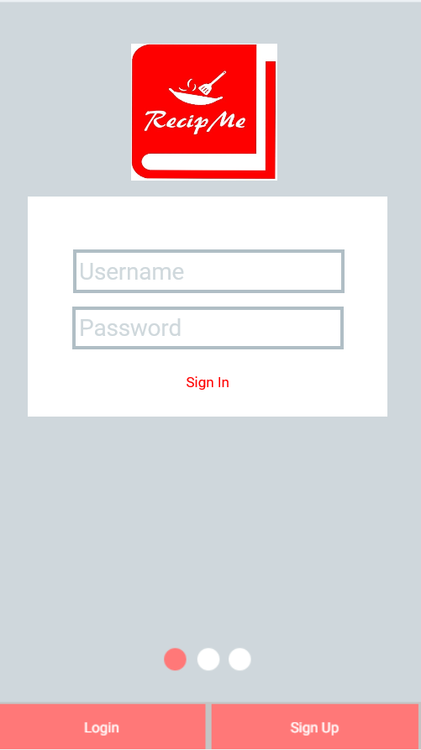
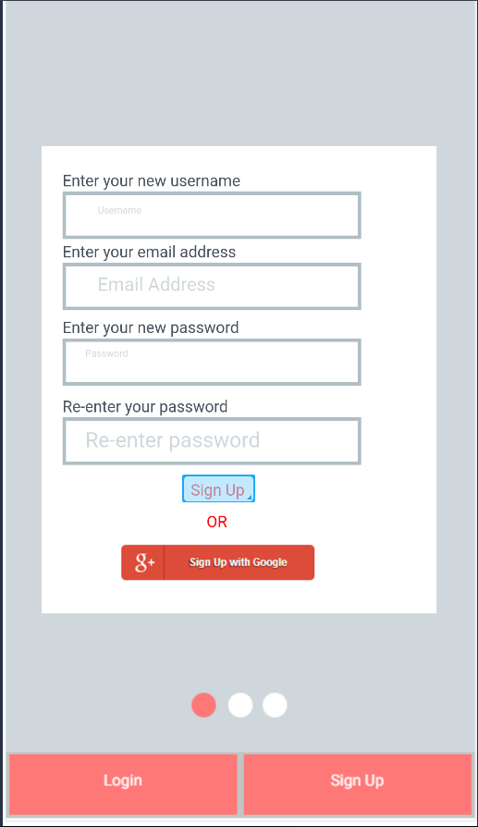
These button should take the user to the home page
The white screen changes as the user clicks on these buttons.
Can sign in with google – Google API runs

Slide 2
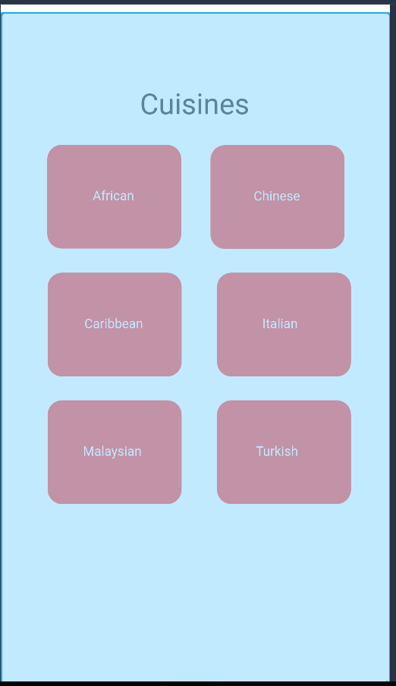
This screen comes up when the user clicks on cuisines from the home screen
Choose a nicer font and be consistent
This text should be bigger

Slide 3
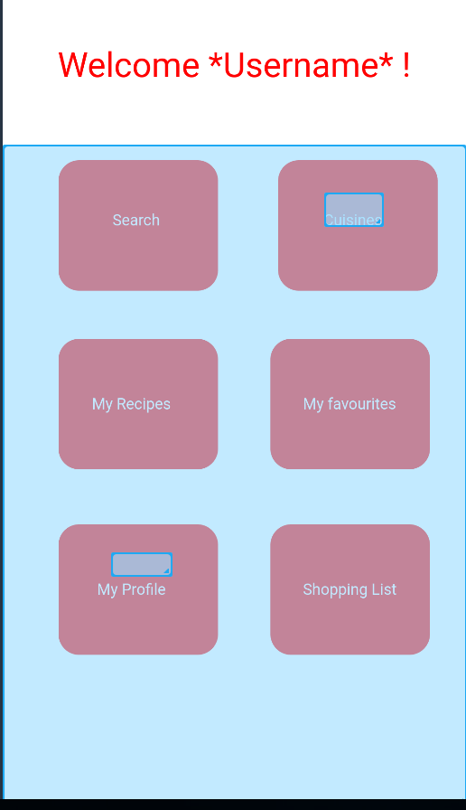
This is the users home screen
Name of the user

Slide 4
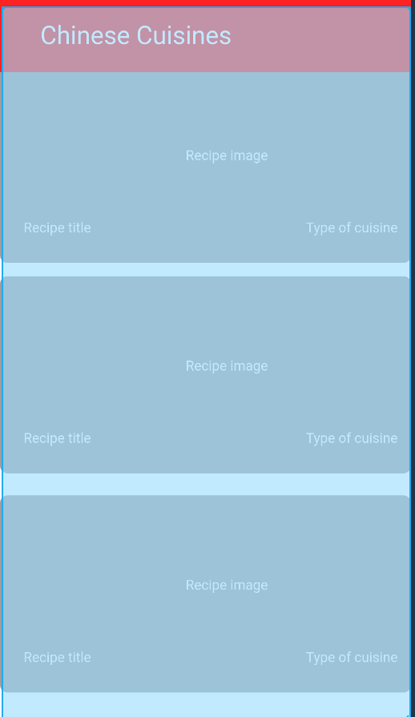
Searches of recipes that the user has searched
Pictures of the recipes, name
This will be replaced – favourites

Slide 5
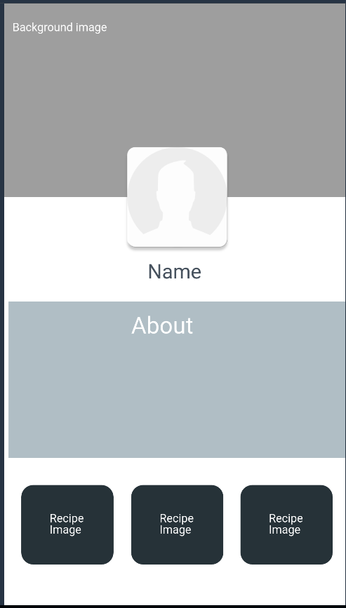
This is the users profile page
This will swipe to the left and right to display their recipes

